Slide 1
ANL201 – Study Units
Time frame and Deliverables
Study Unit | Topic | Date (2022) | Quiz | Deadlines
1 | Business Performance Management Balanced Scorecard Strategy Map | 05th Feb | Pre-Course Quiz 01* | 24th Jan – 4th Feb
2 | All about Data | 10th Feb | Pre-Class Quiz 01* | 7th Feb – 14th Feb
 |  |  | Tutor Marked Assignment | 16th Feb (by 2355 hrs)
3 | Theory/ Foundation to Visualization | 17th Feb | Pre-Class Quiz 02* - | 21st Feb – 28th Mar -
4 | Basic Visualization | 24th Feb
5 | Advanced Visualization | 3rd Mar | Group Based Assignment | 2nd Mar (by 2355 hrs)
6 | Business Performance Dashboard | 10th Mar | End of Course Assessment | 17th Mar (by noon)
*All quizzes have a 12-NOON deadline. No extensions!

Slide 2
Visualisation for Business ANL 201
Overview of Business Performance Measurement Study Unit 1
January 2022

Slide 3
Learning Objectives of ANL201
By the end of this Course
Understand concepts of Business Performance, Measurement, Balanced Scorecard Model and Data Visualization
Compare stages of Data Visualization Process
Data Visualization Components
Design Principles of a Business Performance Dashboard
Appropriateness of Data Visualization techniques based on available data
Appropriates of Business Performance Measure against Business Strategy of Organization
Required Textbooks:
Yau, N,.(2013). Data Points: Visualization that Means Something
Murray, D. G. (2013). Tableau Your Data

Slide 4
Assessment Overview
Assignment 1 | 2% | Pre-Course Quiz 01 24 Jan–4 Feb 2022 1200hrs
 | 2% | Pre-Class Quiz 01 7–14 Feb 2022 1200hrs
 | 2% | Pre-Class Quiz 02 21–28 Feb 2022 1200hrs
Assignment 2 |  | Tutor-marked Assignment 16 February 2022, 2355hrs
Assignment 3 | 38% | Group-Based Assignment (GBA) — comprising of 4 students per group Due 2 Mar 2022 2355hrs
Participation | 6% | Contribution to the class learning experience
Examination | 50% | End-of-Course Assignment (ECA) Due 17 Mar 2022 1200hrs
Notes:
Please change the dates highlighted in red

Slide 5
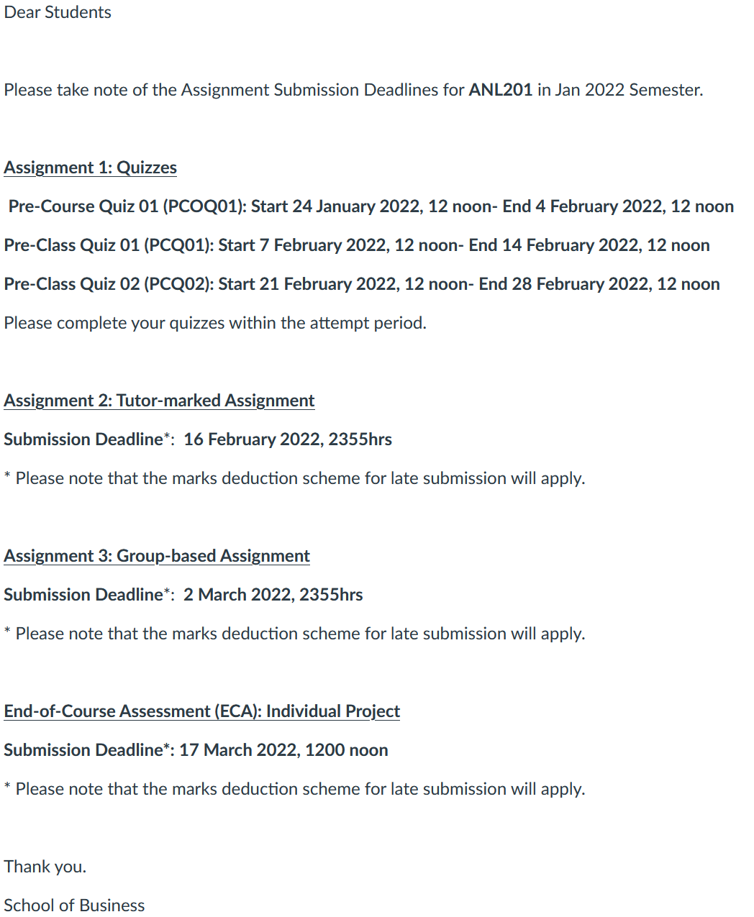
Important Dates
Notes:
To be updated

Slide 6
Installation of Tableau Desktop and Prep
For January 2022 semester, Tableau Desktop 2021.4 will be used for teaching, assessments, and exam
To download Tableau, visit the Tableau for Teaching landing page at https://www.tableau.com/tft/activation
Click on “Download Tableau Desktop”
Fill in your SUSS email address in the “Business E-mail” field, and click on “Download Free Trial”
Go back to the landing page, and click on “Download Tableau Prep”
Activate with this product key: TC3K-D35F-0AC0-8EE3-AE40
Notes:
Updated 2022 license key

Slide 7
Introductions
Name
Profession/ What you do/ What you like
Do you currently use visualisation?
What would be one thing you want to take away from this class?

Slide 8

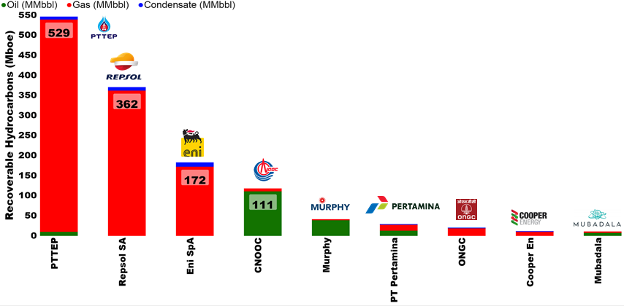
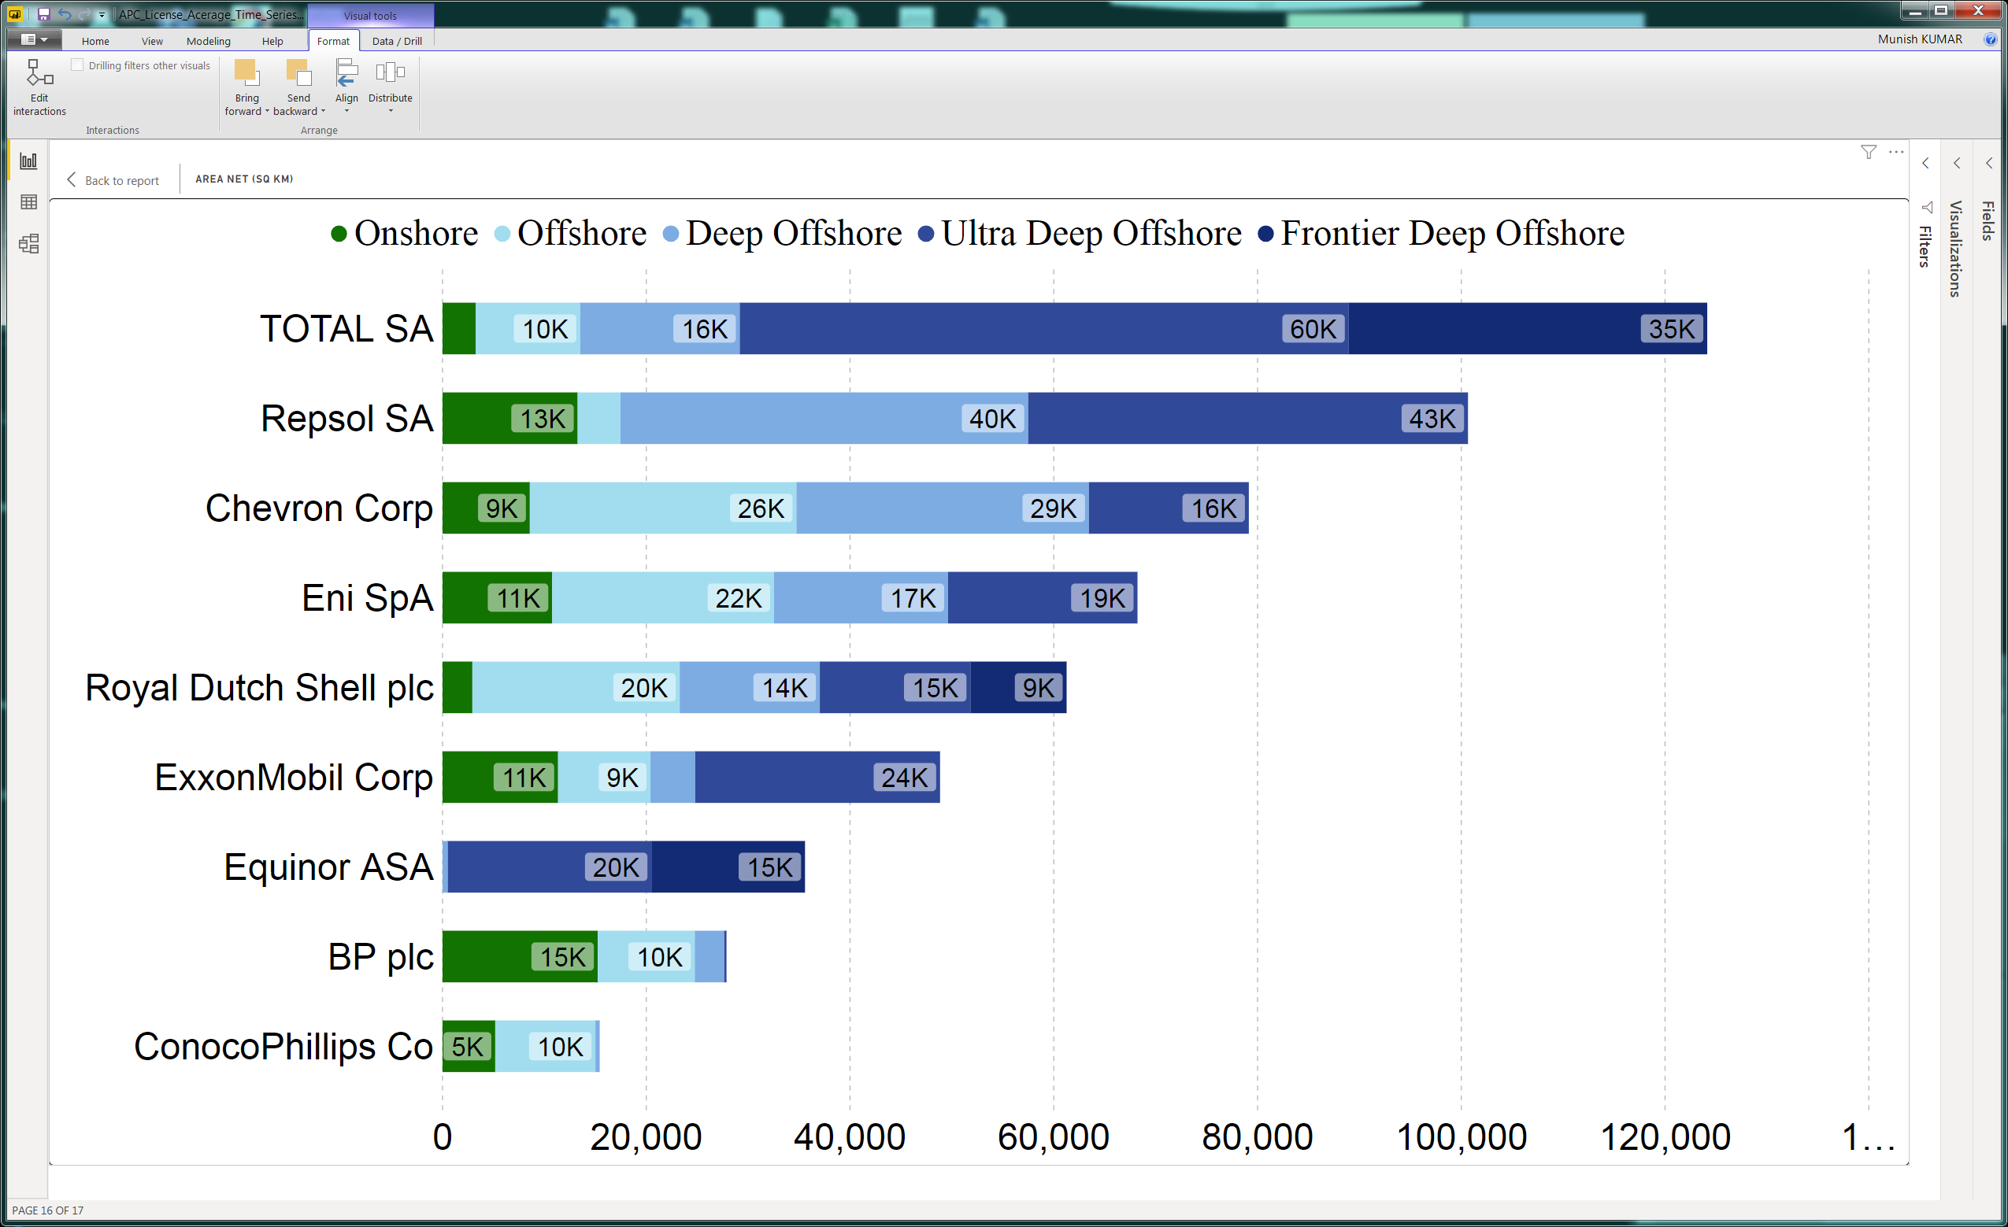
SUSS Associate faculty: Dr Munish Kumar
Email: munishkumar001@suss.edu.sg
Academic Qualification:
Ph.D. Physics, Australian National University
Courses taught at SUSS:
ANL201 Data Visualisation for Business
ANL252 Python for Business
ANL488 Business Analytics Project
Active Area of Work/ Projects:
Energy Auditing (Reserves), Application of Data and visualisation in Oil and Gas, Energy, Renewables Sector
Tools of the trade: Power BI & Python, Tableau.

Slide 9
Business Performance Measurement Concepts

Slide 10
Business Performance Measurement
The big idea – Concepts
Business performance measurement is the process of establishing parameters within which resources, programmes, investments and acquisitions should be in order to achieve desired business results
Through this process, an organisation establishes criteria to determine the quality of their activities, their efficiency, and their effectiveness in conducting their business operations
Business Performance Measurement serves as both a driver and a feedback mechanism for an organisation

Slide 11
Business Performance Measurement
Benefits
Understand an organisation’s inherent strengths and weaknesses
Encourage the organisation to focus on customers’ real needs
Provide relevant training and upgrading skills to employees
Understand an organisation’s past and current financial health
Predict future shortcomings that may arise if not addressed
Improve and control critical processes
Enhance product and service quality
Motivate correct behaviours
Align improvement activities to organisational strategies

Slide 12
Example of Business Performance Measurement
Your goals are important.
Do you know what is normal vs abnormal
Can you explain it?
Customer Survey
100%
Goal
10 Happy & Satisfied Customers
Criteria
No Returns/ Refunds, 5 star rating, Reviews
Measure
Surveys, Interviews, Online Feedback etc
Revenue, Profit-loss, (Text Based) Analytics
How do you do this for 10 Million Customers?
Meaningful Measures
Display the Data
Tell your Story
80%

Slide 13
Business Performance Measurement Model
Organisation
Fundamentals
Processes
Timeline
What has happened
Projected future
Measures
What was undertaken
What was achieved
Objectives
Benchmark
Relative to ?
Performance
Use Judgment to validate or update business
Strategy
Continual Improvement (Feedback)
Means not an End
Linked to BPM
Targets → Execution → Performance (BPM)
Lagging Indicators – past performance does not guarantee future outcomes e.g. Return on Investment
Leading Indicators – Provides (probabilistic) information about the future e.g. customer satisfaction rating
Fundamentals
Operations
Measures
Outcomes

Slide 14
Business Performance Measurement
Pointers for Effective Measurement
Do not confuse business objectives with business performance. Good objectives are the result of organisation exhibiting high business performance
Relevant measures are those that measure activities that can impact strategic objectives
Business processes are often made up of activities that involve many different business functions or departments. Therefore, measuring business process performance reflects more on the organisation’s business performance than individual activities within a business function or department

Slide 15
Business Performance Measurement
Pointers for Effective Measurement
Measurements should relate to customer’s perspective of good business performance rather than to internal manager’s perspective
The measuring method is as important as the selection of measures. Furthermore, measuring method is subjective and complex in nature
Measures should be used as a basis for improving business processes rather than finding faults

Slide 16
Business Performance Measurement
Pointers for Effective Measurement
Measures shape employee behaviour, and therein lies the danger that employees seeking to improve a particular measure in a specific area which may have adverse consequences in other areas
Define measures precisely and execute measurements accurately within the context of justifiable costs and feasibility

Slide 17
The Balanced Scorecard
(15 Min break)

Slide 18
The Balanced Scorecard
What is Strategy?
A business strategy is a set of guiding principles that, when communicated and adopted in the organization, generates a desired pattern of decision making
A strategy is therefore about how people throughout the organization should make decisions and allocate resources in order accomplish key objectives
A good strategy provides a clear roadmap, consisting of a set of guiding principles or rules, that defines the actions people in the business should take (and not take) and the things they should prioritize (and not prioritize) to achieve desired goals
Demystifying Strategy: The What, Who, How, and Why Michael D. Watkins, Harvard Business Review, 10 Sep 2007

Slide 19
The Balanced Scorecard
Principles of Strategy Focused Organisations
Ensure that measurement considerations are always appropriate for the organisation’s current strategy (which will change over time)
Manage both tangible and intangible assets
Go beyond traditional, slow reacting, and tactical management control systems (e.g., budgeting) which may be inadequate for today’s dynamic, rapidly changing business environment

Slide 20
The Balanced Scorecard
Concepts of the Balanced Scorecard (BSC) Model
The BSC is meant to provide a holistic view of an organisation’s overall performance that incorporates both financial and non-financial measures
Without a BSC approach, organisations tend to be judged only by short-term financial results, and this may hide serious problems
The BSC enables organisations to clarify their visions and strategies, put them into action, and provide feedback around both internal business processes as well as external objectives to continuously improve strategic performance and results

Slide 21
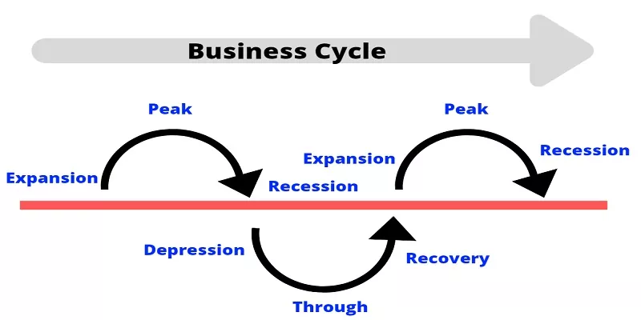
The Balanced Scorecard
Counter Cyclic Investment Strategy
Strategy should be proactive not reactive; not driven by financial desires but more real goals
A reactive strategy is one often taken by many companies
If price or demand for product rises, companies will spend, to capture market share, stifle competition, etc. This creates inefficiencies both internally and externally
If price/ demand falls, they cut cost to bolster short term financial results
Some companies however are strategic and invest “counter cyclically”
If price/ demand rise, they maintain status quo, keep growing at a steady pace and while they focus on the competition, its more to ensure they know rival behavior. Losses are projected as “short term falls”
If price/ demand fall, companies invest. They ramp up hiring, spend on R&D, train their people – this means that at the next positive wave, the company is positioned to surge ahead of its competition

Slide 22
The Balanced Scorecard
Develop Measures
Collect Data
Analyze Results
The Four Balanced Scorecard Perspectives
Financial
How should we appear to stakeholders?
Customer
How should we appear to our customers?
Internal Business Processes
What business processes must we excel at?
Vision & Strategy
Learning & Growth
How could we continue to improve and create value?
Innovation & Development

Slide 23
The Balanced Scorecard
The Financial Perspective (FP)
Although the concept of the BSC is to take performance in many non-financial areas into consideration, the measures in the financial perspective must eventually show gains in order for the organisation to conclude that its overall performance has indeed improved
The measures for the other three perspectives that relate to customer, internal business process and people must be appropriately selected in order (for financial performance) to yield results
Financial matters (growth, profitability, share holder value) are important, but an over-emphasis can lead to an “unbalanced” views of performance. Consider Risk, Cost-Benefit, SWOT etc
Notes:
If the measures in the financial perspective are not showing gains while measures in the other three perspectives are, it could mean that the organisation has set the wrong goals

Slide 24
The Balanced Scorecard
The Customer Perspective (CP)
Under the Customer Perspective, an organisation needs to determine what the customers require and think are important in terms of the products and services that the organisation provides them
Organisations have to establish goals for each key requirement
Measures are then selected to gauge the organisation’s success in achieving these goals
Customers want flexibility, time, quality, service, performance and value

Slide 25
The Balanced Scorecard
The Internal Business Processes Perspective (IBP)
Measures based upon internal processes perspective allow managers to know how well their business is running, and whether their products and services meet customer requirements
Organisations must identify key business processes that need to be excelled in terms of organisation’s operations
Measures are then established to monitor the performance of these key business processes
Dependent on the unique product offering of your industry

Slide 26
The Balanced Scorecard
The Learning and Growth Perspective (LG)
This perspective includes employee training and corporate cultural attitudes related to both the individual and corporate self-improvement, product and service innovation, and organisational development
Organisations have to establish goals that relate to innovation, growth and development
Measures are then selected so that they can gauge the organisation’s success in achieving these goals
This measure is a bit more abstract because people (or rather their skills, knowledge, learning) are the key resource; a good manager is someone who does not see people as just ‘cost’. Rather, the the investment of time/ effort/ technology should be viewed as a means to (in the longer term) boost innovation and help the company develop new ideas.

Slide 27
The Balanced Scorecard
The BSC provides
Focus
Motivation
Accountability
for all organisations
Provides a linkage between existence (customers) and outcomes (shareholders) by communicating the performance drivers for going from point A to B
I will grow my company by 10%, by spending $150M, while maintaining our core focus of safety, customer service and timeliness.

Slide 28
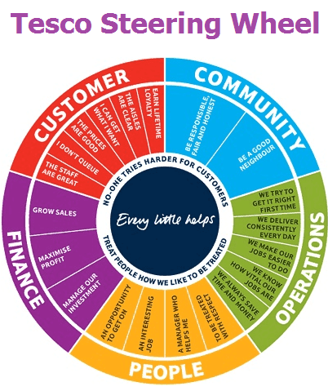
The Balanced Scorecard
An illustration — Tesco
Source: www.tesco-careers.com
Notes:
Strategic ‘Steering Wheel’, divided into five radial slices - Customer, Community, Operations, People and Finance. Each slice is subdivided into specific objectives – for example the ‘Customer’ slice contains ‘Earn Lifetime Loyalty’, ‘The Aisles Are Clear’, ‘I Can Get What I Want’, ‘The Prices Are Good’, ‘I Don’t Queue’ and ‘The Staff Are Great’.
The steering wheel gives a clear prescription on what should be measured in order to balance the financial perspective.

Slide 29
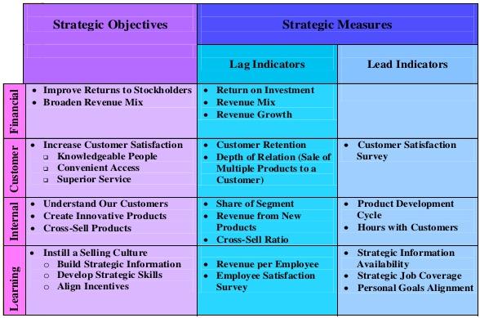
The Balanced Scorecard
An illustration — Bank
Source: http://image.slidesharecdn.com/presentation1cc-140220094550-phpapp01/95/the-balance-scorecard-44-638.jpg?cb=1392889762
Notes:
Example of objectives linked to each balanced scorecard perspectives.

Slide 30
Class Discussion 1
What are some of the possible measures for each of the four Balanced Scorecard perspectives?

Slide 31
Class Discussion 1
What are some of the possible measures for each of the four Balanced Scorecard perspectives?
Financial
Sales growth, Cash Flow, Return on Investment
Customer
Satisfaction level, Acquisition, Retention, Market share
Vision
Strategy
Internal Business Processes
Product Quality, Cycle Time, New Product Lead Time
Learning & Growth
Employee Retention, Skill sets, Number of new products,

Slide 32
The Strategy Map

Slide 33
The Strategy Map
Four Elements of a Strategic Framework
Mission is about what will be achieved (why we exist)
The Value Network is about with whom value will be created and captured
Strategy is about how resources should be allocated to accomplish the mission in the context of the value network
Vision (desired future state) and Incentives are about why people in the organization should feel motivated to perform at a high level
Demystifying Strategy: The What, Who, How, and Why Michael D. Watkins, Harvard Business Review, 10 Sep 2007

Slide 34
The Strategy Map
The need for a Strategic Framework
Mission is about what will be achieved; the value network is about with whom value will be created and captured; strategy is about how resources should be allocated to accomplish the mission in the context of the value network; and vision and incentives are about why people in the organization should feel motivated to perform at a high level
Together, the mission, network, strategy, and vision define the strategic direction for a business. They provide the what, who, how, and why necessary to powerfully align action in complex organizations
Demystifying Strategy: The What, Who, How, and Why Michael D. Watkins, Harvard Business Review, 10 Sep 2007

Slide 35
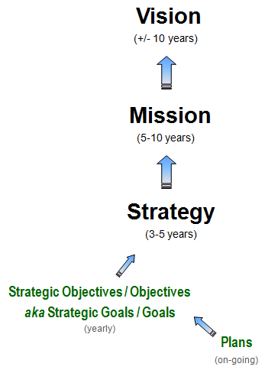
The Strategy Map
Vision, Mission and Strategy
A Vision Statement sets out the desired future state of the organization
A Mission Statement is the reason for the organisation to exist
A strategy is not formulated in a vacuum. It is usually guided by the organisation’s mission, vision, and core values.

Slide 36
The Strategy Map
Using BSC as a platform, strategic objectives can be established for any broad strategy defined by the organisation. Like the BSC as well, having a “defining question” for that objective is very helpful
The need for Strategic Objectives (Goals)
Strategic Objectives are briefly defined objectives on the strategy map which require further supporting information, initiatives and plans on how they can be achieved
Performance management begins with Strategic Objectives
Strategic Objectives focus limited resources on things that matter most
In the absence of Strategic Objectives, financial and human resources would be wasted on activities that contribute little towards organisational success

Slide 37
The Strategy Map
Return to this later under “Internalisation of Business Performance Measurements”
Accomplishing the Objectives
The right Business Performance Measures (BPM) must first be defined
BPM provides objective information on effectiveness and efficiency of process
Considerations are:
Will the measure have an impact on the objective?
Is it measurable (e.g., budget, people served)?
Is the data easily available (part of standardisation or do you need technology)?
Frequency of measurement (too frequent and it disrupts operations, too little and its inaccurate)
Might need to also consider whether we can measure parts or the whole, in which case a “proxy” (indirect) measure is used e.g. effectiveness of treatment can use a patient's recovery time.

Slide 38
The Strategy Map
Cause and Effect Relationships within the Strategy Map
In a strategy map, individual Strategic Objectives are positioned systematically to demonstrate the relationships between them, and reveal the logic under each Strategic Theme
Each Strategic Objective is related and linked to other Strategic Objectives on the strategy map using lines that represent cause-and-effect relationships. Such linkages logically reflect the natural value chain and culture. The strategy map also illustrates how the achievement of one objective enables the achievement of another, and captures the underlying hypotheses for the strategy

Slide 39
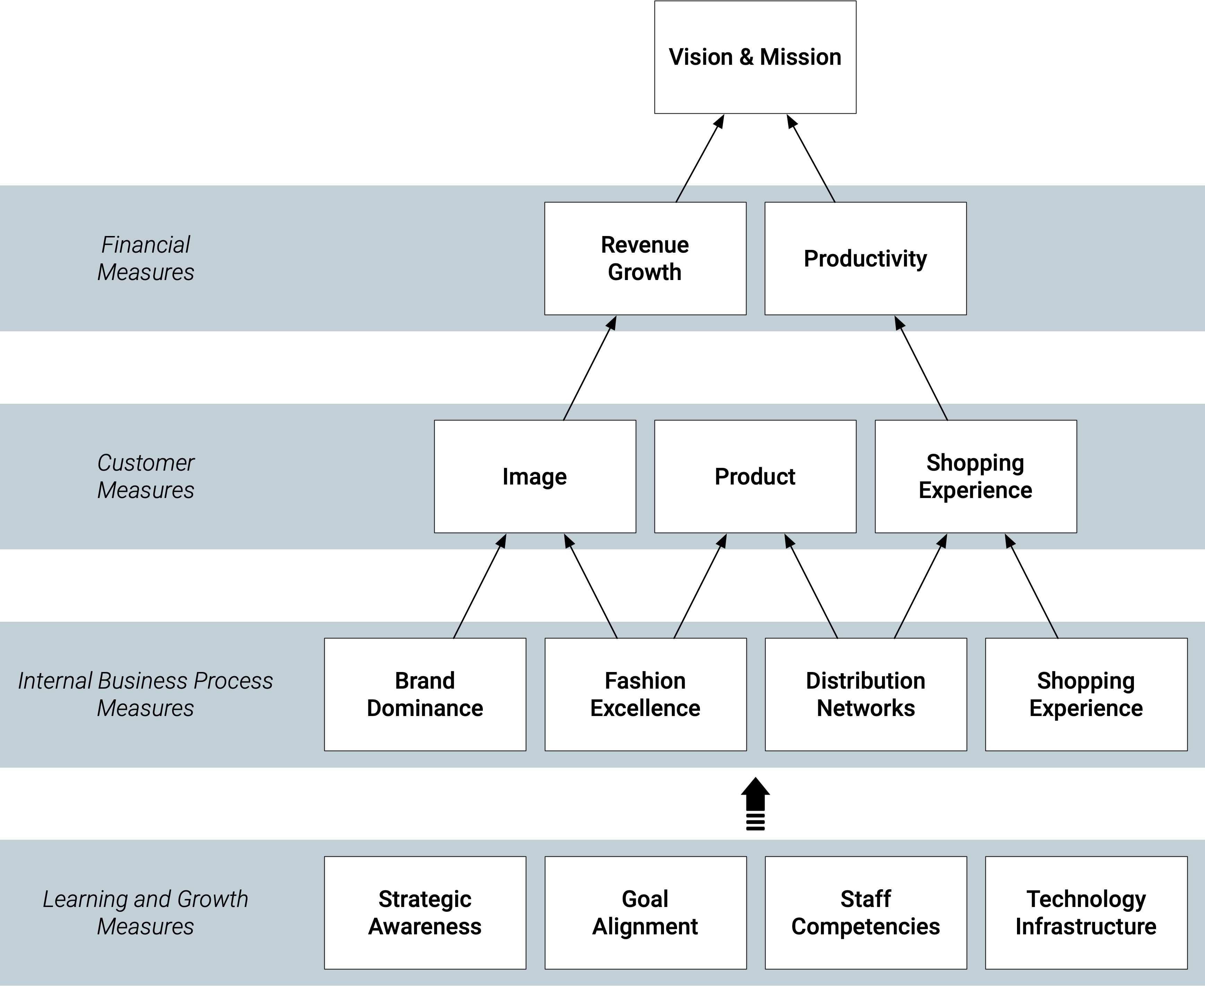
The Strategy Map
Example of a Strategy Map
A Fashion Retailer’s Balanced Scorecard Strategy Map

Slide 40
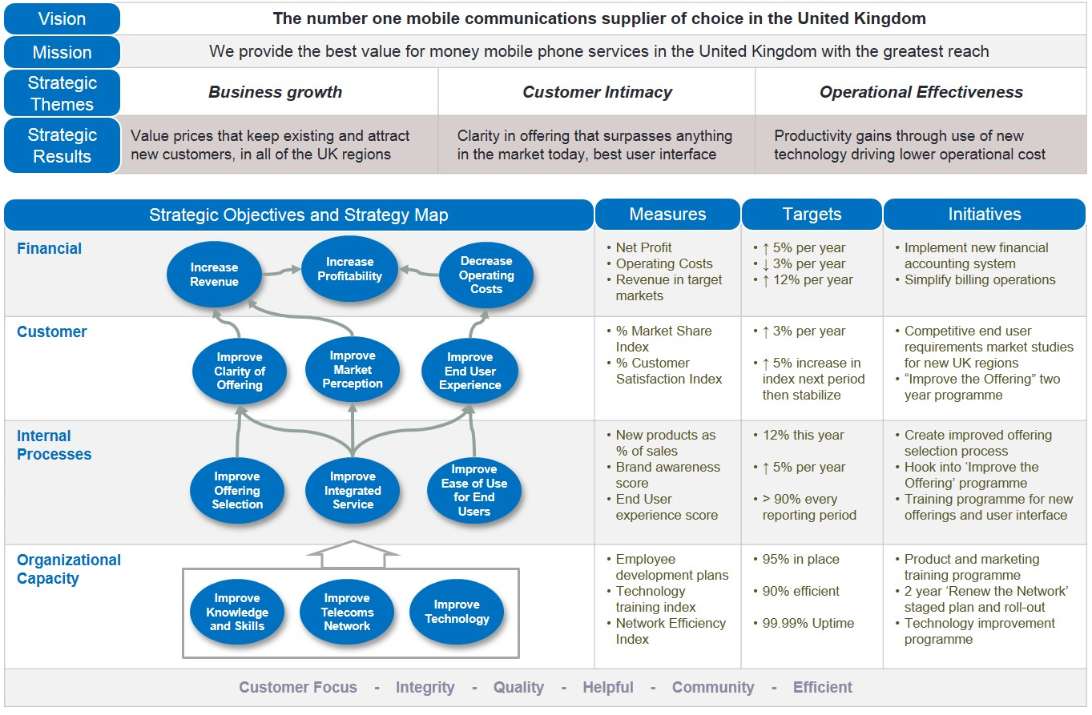
Strategic Initiatives
An illustration — Mobile Network Provider
Strategic Initiatives are specific projects, programmes or planned activities directed at key processes for the purpose of enhancing output performance, and to meet or exceed the established targets
Source: https://www.intrafocus.com/wp-content/uploads/2015/03/Integrated-Strategy-Map.jpg

Slide 41
Internalisation of Business Performance Measurement
(15 Min break)

Slide 42
Internalisation of Business Performance Measurement
Selecting what to Measure
Considerations when deciding what to measure,
Whether the measure has an impact on a strategic objective,
Whether the measure is measurable,
Whether the data is easily available and accessible, and
The measurement frequency.

Slide 43
Internalisation of Business Performance Measurement
Linking Organisational Strategy to Business Performance Measures
Business Performance Measures are intended to provide objective information on the effectiveness and efficiency of a particular process or activity. This will lead to the accomplishment of goals
Linking a performance measure to a strategic objective provides relevance for the measurement. It also helps drive the organisation’s activities towards achieving the organisation’s strategy
Processes are then designed to collect data for these relevant measures with the objective of improving collection efficiency, storage, and presentation

Slide 44
Internalisation of Business Performance Measurement
Examples of “Bad” Measures
A manager of a fast-food restaurant striving to achieve an award for attaining a perfect 100% on the restaurant's "chicken efficiency" measure (the ratio of how many pieces of chicken sold to the number thrown away) did so by waiting until the chicken was ordered before cooking it. He won the award, but drove the restaurant out of business because of the long wait times.
A company's measures showed a near-perfect delivery record, yet some 50% of customers complained of their products arriving late. To attain rewards the company had adopted a measure of on-time delivery that only reflected whether the product had left its plant on-time.
An automobile industry executive explained that to receive his quarterly bonuses "all that mattered was meeting production quotas and getting the cars out of the factory." What happened after that was somebody else's problem.

Slide 45
Internalisation of Business Performance Measurement
Constructing Appropriate Measures
Lagging measures focus on results at the end of a time period. Based on historical performance
Leading measures drive or lead to the performance of lagging measures. They measure intermediate process and activities
The Balanced Scorecard should contain a mix of leading and lagging indicators
Proxy measures are an alternative choice of measurement when a direct measure is unavailable

Slide 46
Internalisation of Business Performance Measurement
Constructing Appropriate Measures
 | Lagging | Leading
Definition | Measures focus on results at the end of a certain period. Based on historical performance. | Measures that drive or lead to the performance of lag measures. Measures intermediate processes and activities.
Examples | Revenue Employee Turnover Rate | Punctuality Absenteeism
Advantages | Often easy to identify and capture. | Predictive in nature, and allow an organisation to adjust based on results.
Issues | Historical in nature and do not reflect current activities. Lack predictive power. | May be difficult to identify and capture. Often, new measures have no history.

Slide 47
Class Discussion 2
What are some of the possible leading and lagging indicators of an organisation/ the organisation you are currently working for?

Slide 48
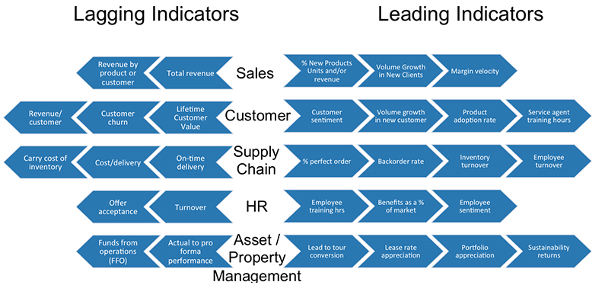
Class Discussion 2
What are some of the possible leading and lagging indicators of an organisation/ the organisation you are currently working for?
Source: https://www.clearpeak.com/wp-content/uploads/2016/01/lagginggraph.jpg

Slide 49
Internalisation of Business Performance Measurement
Setting Appropriate Targets
A systematic approach towards setting up targets can start by specifying the target for each strategic objective, and subsequently to each measure
Business Performance Targets can be short-term (achieve within one year), mid-term (achieve within three years), or long term (achieve within five years). They usually correspond to an organisation’s Strategic Objectives in terms of being incremental objectives, stretch objectives and visionary objectives respectively
Targets should be (1) easily understood and communicated, (2) clear in establishing expectations, and (3) encouragements given to stretch performance

Slide 50
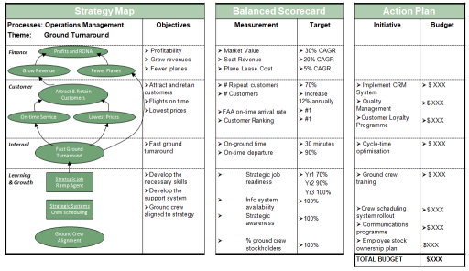
Internalisation of Business Performance Measurement
An effective and sustainable Business Performance Measurement should be balanced by placing an appropriate balanced focus on the number of measures in all four BSC perspectives. There must be cause-and-effect relationships amongst Strategies, Strategic Objectives, Measures, and Targets.
Source: https://bizperfblog.files.wordpress.com/2010/12/strategymapalignedtobscsmall.png

Slide 51
Class Discussion 3
In designing the right measure, what are the important considerations?
Measureable
Refutable
Non-actionable
Data is easily available
Determine the appropriate time period for every measure

Slide 52
Class Discussion 3
In designing the right measure, what are the important considerations?
√Measureable
X Refutable
X Non-actionable
√ Data is easily available
√ Determine the appropriate time period for every measure

Slide 53
Internalisation of Business Performance Measurement
Obstacles in Implementing and Sustaining Business Performance Measurement Systems
Lack of senior management support
Too few individuals involved
Too little consensus on measures
Consensus sought only from the top management and not the others
Keeping scorecard only at the top management
Prolonged development of the scorecard
Scorecard that is alienated from organisation strategy
Treat the Balanced Scorecard as a system project
Hire inexperienced Business Performance Management consultants
Notes:
Using the Balanced Scorecard to translate corporate strategies into actionable strategic goals is an efficient way to operationalise some of the principles of strategic Business Performance Management.
There are some obstacles to the successful implementation of Business Performance Measurement Systems. Below are the obstacles highlighted by Kaplan and Norton in their publication in 2005.
Implementation of a Business Performance Measurement System introduces something new that may not be immediately accepted by an organisation. It is critical to communicate (initial and on-going) with the employees regarding such new implementations.

Slide 54
Internalisation of Business Performance Measurement
Success Factors for Implementing and Sustaining Business Performance Measurement Systems
Top management support
Project champion
Adequate resources
Employee participation
Concise reporting
Linkage amongst Strategy, Strategic Themes, Strategic Objectives, Business Performance Measures, Business Performance Targets, and Strategic Initiatives

Slide 55
Summary
A strategy is guided by an organisation’s mission, vision and core values.
Strategic Themes are to create shared understanding of what Strategic Objectives are and actions to focus on.
Performance Management begins with Strategic Objectives.
Well defined Business Performance Measures provide the management with a tool to gauge organisational progress.
Targets can form the basis for establishing internal benchmarks, or best practices for improving internal business processes.
Strategic initiatives bring the level of performance up to a desirable level.
The cause-and-effect relationships are critical components of a Strategy Map.

Slide 56
Discussion
Develop a strategy map
In groups of 3-4, describe and develop a strategy map for an organization (of your choice, e.g. a pizza franchise). It could be a company that you have worked in. Make use of the Balanced Scorecard and other concepts to illustrate the strategy map.
Notes:
Break the class into groups of 3 or 4, and have them discussed the development of a strategy map, using concepts from the Balanced Scorecard, as well vision and mission statements. Have the groups discussed the different aspects of the BSC (Financial, Customer, Internal Business Process, Learning and Growth).

Slide 57
Asia Pacific Strategy – 2015 Performance and commitments
Results as of Annual Shareholder Meeting
(FP)
(FP)
(FP/ IBP)
Promote HSE as a CORE VALUE
Grow
75-100K
New customers (3 Year Average)
CAPTURE
10% market share
(Yearly Average)
REDUCE UNWANTED COMMITMENTS to 0M$
By 2020
2014:
60 K, 148 M$ spent
2014 Capture:
9% (based on total revenue)
Divestment of poorly operating units
(IBP)
(IBP/LG)
(CP/FP)
(LG/CP/FP)
12 Product Maturation Meeting by Country
Product Maturation Plan
KPI: 80% “Maturation Activity”
PROPOSE
2 Products PER YEAR
(1 upgrade, 1 flagship)
Submit
4 Patents in Tableau
and mentor/ train
10 New Employees
per year in Tableau
Product
Maturation
6 Meetings to date
Currently 36% NEW prospectivity.
Upgrades to benefit/ retain existing (60K) customers
Flagship to capture >1% more of market share
Increase product offering for customers
Diversify Company Revenue Streams
Retain and develop talent (Tableau skills at 600 people or 40% of total workforce)

Slide 58
Tableau (Class Activity)

Slide 59
Tableau (Class Activity)
Follow your instructor for the followings exercises:
Import Excel data: global_superstore_2016.xlsx (orders)
Build a simple worksheet
Notes:
Demo on superstore (Excel) for order table
Creating the worksheet

Slide 60
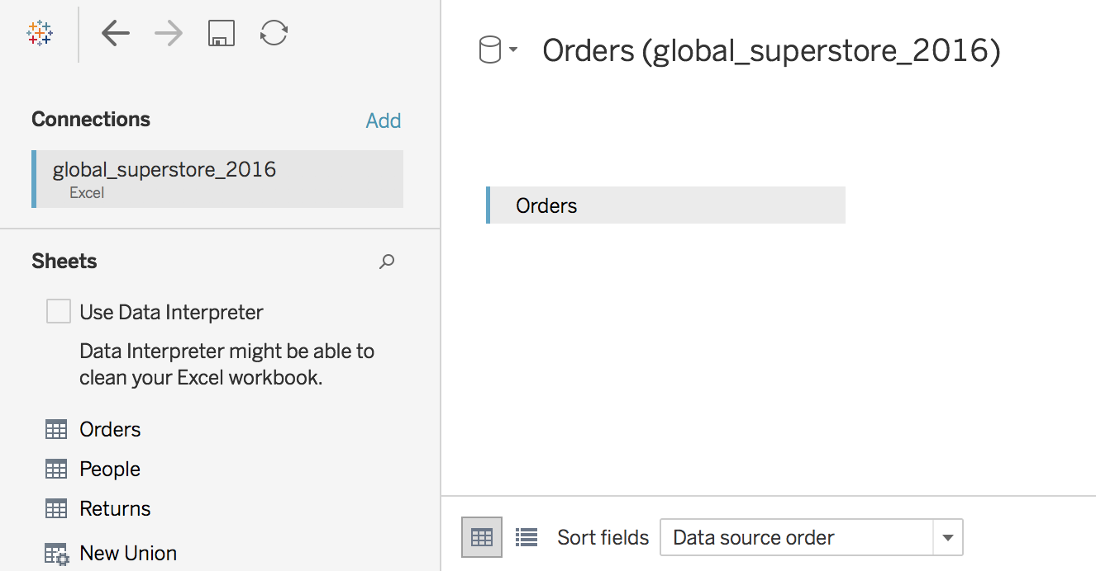
Tableau (Class Activity)

Slide 61
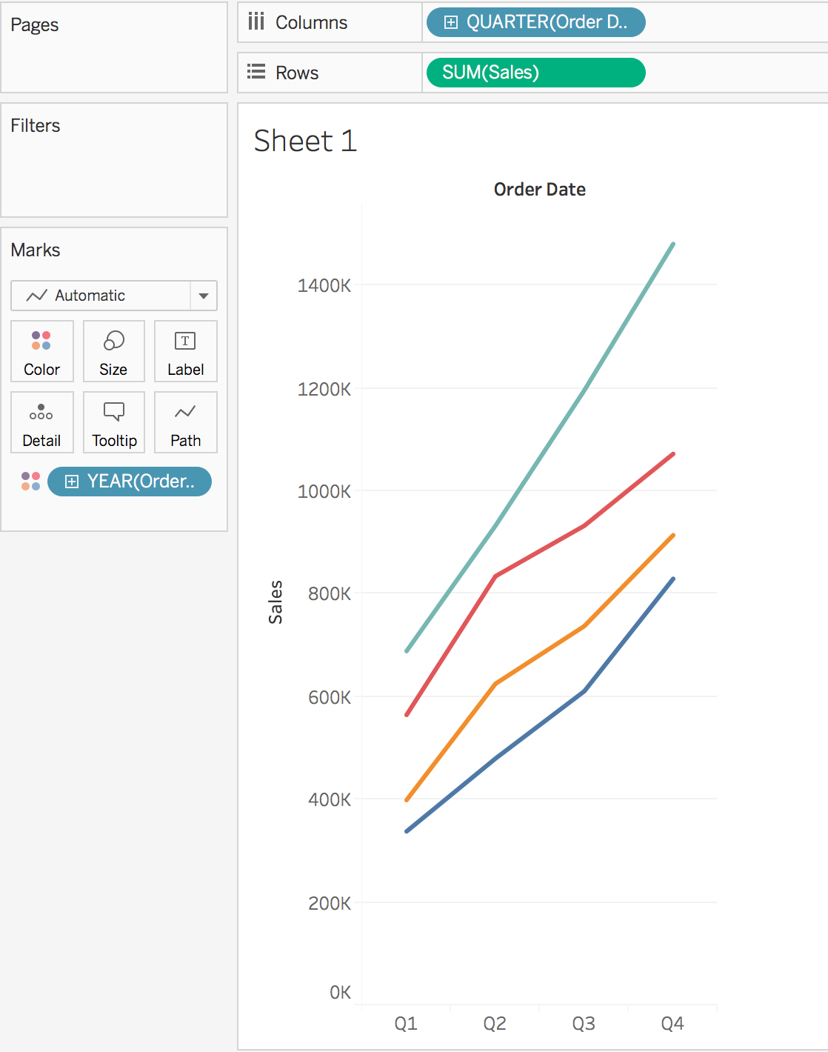
Tableau (Class Activity)

Slide 62
Tableau File Extension
File Type | File Extension | Purpose
Tableau Workbook | .twb | It contains information on each sheet and dashboard that is present in a workbook. It has the details of the fields which are used in each view and the formula applied to the aggregation of the measures. It also has the formatting and styles applied. It also contains the data source connection information and any metadata information created for that connection.
Tableau Packaged Workbook | .twbx | This file format contains the details of workbook as well as the local data that is used in the analysis. Its purpose is to be share with other Tableau desktop or Tableau reader users assuming it does not need data from the server.
Tableau Data source | .tds | The details of the connection used to create the tableau report are stored in this file. In the connection details it stores the source type(excel/relational/sap etc.) as well as the data types of the columns.
Tableau Packaged Data source | .tdsx | This file is similar to the .tds file with the addition of data along with the connection details.
Tableau Data Extract | .tde | This file contains the data used in a .twb file in a highly compressed columnar data format. This helps in storage optimization. It also saves the aggregated calculations that are applied in the analysis. This file should be refreshed to get the updated data form the source.

Slide 63
Course Homepage | https://canvas.suss.edu.sg/courses/31564
Study Guide | https://ibookstore.suss.edu.sg/
Tableau Desktop | https://www.tableau.com/products/trial
Tableau Tutorials | https://www.tableau.com/learn/get-started/creator
Academic Calendar | https://www.suss.edu.sg/docs/default-source/contentdoc/oas/pt-2021acadcalendar.pdf

Slide 64
Tableau Desktop System Requirements
Windows
Windows 7 or newer (64 bit)
Intel Pentium 4 or AMD Opteron processor or faster
2 GB memory
1.5 GB minimum free disk space
Mac
iMac/MacBook computers 2009 or newer
macOS High Sierra 10.13 and macOS Mojave 10.14
1.5 GB minimum free disk space
Notes:
Get licenses for students at https://www.tableau.com/academic/teaching/course-licenses

Slide 65
Tableau Prep Builder System Requirements
Windows
Windows 7 or newer (64 bit)
Intel Core i3 or AMD Ryzen 3 Pro or faster
4 GB memory
2 GB minimum free disk space
Mac
macOS High Sierra 10.13 and macOS Mojave 10.14
Intel Core i3 or faster
4 GB memory
2 GB minimum free disk space

